Slide 1
EGYPT Meeting the Development Challenge Reforms for Promoting Economic Growth

Slide 2
Outline
Part I:
Background
Part II: Micro-finance
Part III: Wealth Creation
Part IV: Education
Part V: Urban Planning
Part VI: Outsourcing

Slide 3
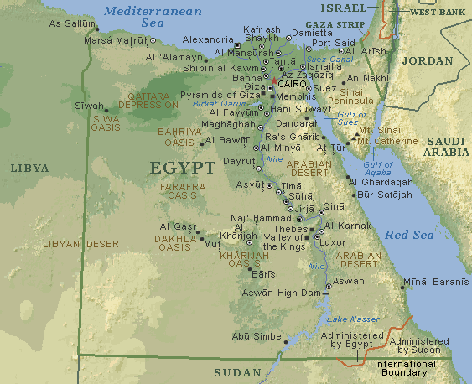
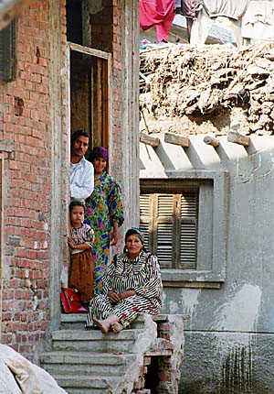
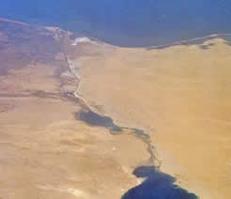
Background Part I
Egypt has introduced a multitude of reforms in recent years to:
Increase levels of competitiveness,
Accommodate job creation needs,
Improve human development needs, and
Sustain GDP growth under stable conditions.
Despite significant progress in a number of sectors, Egypt’s most significant challenge remains on the local economic development front– where limited progress has been made
This is owing to the fact that local governorates with the largest populations (e.g. Sohag) and one-company towns (e.g. Mahalla) continue to exhibit tremendous levels of poverty, and remain in a cycle of economic stagnation– with few prospects for a turnaround

Slide 4
Background Part I
For Egypt to effectively confront the challenges of the 21st century, a radical strategy must be pursued to significantly overhaul the economic, institutional, educational, scientific and technological conditions within its largest governorates.
This presentation seeks to outline a strategy that facilitates local economic development by providing each of these governorates with a level of autonomy, supported by strong institutions and economic structures at the national-level, similar to how states are governed in the US.
The focus of this strategy is on increasing the competitiveness of these local economies, in order to stimulate intrinsic growth and create a modern functioning economy that leverages Egypt’s multitude of resources at the local-level.

Slide 5
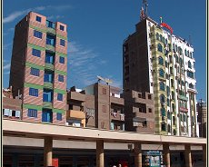
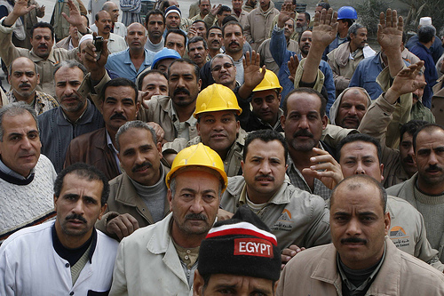
Example of Governorates Part I
Sohag
Mahalla
Characteristics
Population: Over 3.5 million
Location: Central Egypt
Key Industries: Ginned cotton and Silk weaving
Cause for Intervention: Average farm sizes are so small that 93% of population has too little land to produce an income equivalent to the poverty line
Characteristics
Population: Over 500,000
Location: Middle of the Nile Delta
Key Industries: Textiles and Clothing
Cause for Intervention: Local economy fully dependent on single industry with disgruntled labor force

Slide 6
The Proposed Strategy Part I
The proposed approach involves developing teams of experts that would work with the national and local governments, as well as local stakeholders in five key areas:
Microfinance
Wealth creation
Education
Urban Planning
Outsourcing
These teams would be operating out of each of the targeted governorates, and would have an engagement period of no less than three to five years.
The focus of these teams would be to help embed a local competitive framework that would stand at the core of the regional transformation process

Slide 7
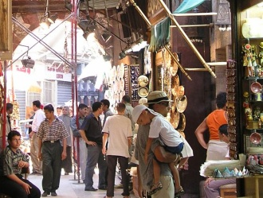
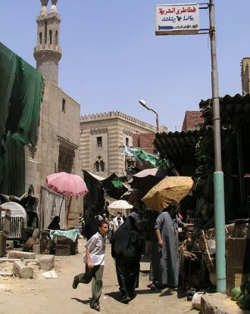
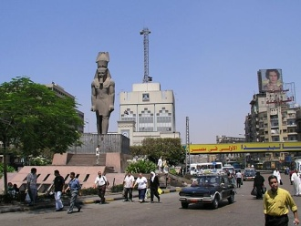
Micro-Finance Part II
The micro-finance team would be charged with the development of effective micro-finance schemes targeted at the ‘poorest of the poor’
One component would involve a tie-in to the new mortgage law, seeking to assist with helping citizens own their own homes, with a second component focusing on small and medium enterprise (SME) development
Nobel laureate Mohamed Yunus developed a similar program to the micro-loans initiative in this context, turning $27 in funding into $15 billion in Bangladesh
The initiative would support loans of $500 or less for local populace to help them meet short-term funding needs (such as helping a daughter with a wedding, etc.)

Slide 8
Micro-Finance Part II
Short-Term Micro-Loans
The micro-loans program would involve establishing and raising capital for a small public sector banking institution that would assist in the disbursement of micro-loans to local populace who may not be in a position to provide collateral
These loans would fund activities that range from buying a dairy cow to investing in small oven
These programs would involve a high-level of personal attention, as evidenced by the ‘Yunus model’ lead to very high repayment rates
Yunus’ Grameen Bank off-sets weekly meetings with its borrows with high interest rates (up to 20 percent) to help the borrows succeed by leveraging the help of experts who can assist them in their business goals and have yielded exceptional results in terms of loan repayments and bringing locals out of poverty
The success of this program will hinge on ensuring that the banking institution is not only a lender, but also an advisor that acts as a de-facto incubator

Slide 9
Micro-Finance Part II
The micro-loans program would be the first phase in a three-pronged investment strategy that focuses on developing a competitive local economy:
Capacity Building
Enterprise Cycle
Financing
Hands-on training
Prototype business ideas
Advisory services for business planning
Business Incubators
Advisory services/More specialized training
Office space and services
Growth
Development
Startup
Pre-start
Private
Investors
.Government
Institutional Investors
Micro-lending
Own Funds
SME lending
Micro-leasing

Slide 10
Micro-Finance Part II
SME Development
SME Development would build on successful initiatives from the “Pre-start” program by leveraging a more dynamic business enabling environment and better-suited labor force to assist local entrepreneurs take on slightly larger loans that are needed to help expand their businesses
This would require changes to the local business environment:
For example, the Government would facilitate a mechanism to help companies register and transition to the white economy
Support services/incubators that focus on productivity, growth and SME competitiveness
Following the U.S. model: teaming up and growing business base
Enhance diversification, equity base, and availability of sources of finance to SMEs

Slide 11
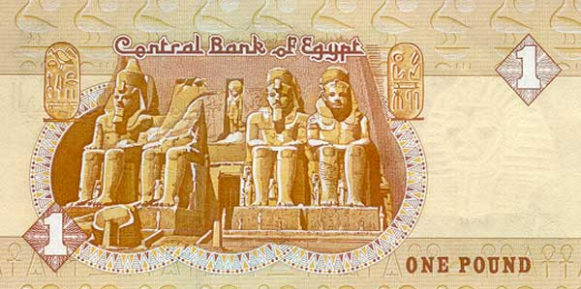
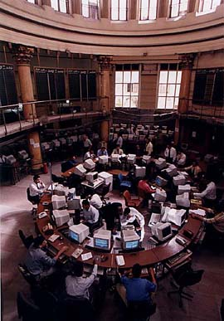
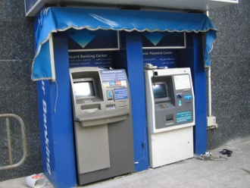
Wealth Creation Part III
Wealth creation (NOT employment creation) would focus on identifying avenues to create and establish bases of wealth transfer to the impoverished regions
The initiative would create a cornerstone of a viable business sector to grow within target cities
The micro-finance institutions established under ‘Part II” would have a key role to play within this initiative
An effort would be made to support the establishment of small businesses (e.g. for bottling juice)
The institutions would provide SEED capital, and act as a partner by providing access to experts that can help instill an entrepreneurial mindset and bring experience to the table
The institutions would have an ownership stake in the enterprises, with the wealth generated shared with the locals

Slide 12
Wealth Creation Part III
INNOVATION
Providing funding
Providing facilities and/or resources
Providing knowledge of local markets and/or business environment
Assisting in the learning or acquisition of business expertise (e.g. accounting/finance/legal...etc.)
BUSINESS VENTURE

