Slide 1
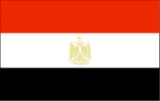
Egypt: Meeting the Development Challenge through the Year 2025
Dr. Khaled F. Sherif
Sector Manager
Private and Finance Development Sector Unit
Eastern Europe & Central Asia Region
The World Bank

Slide 2
Outline
Chapter 1: The Challenge of the Emerging Labor Force
Chapter 2: The Challenges to Regional Development
Chapter 3: Planning Industrial Development
Chapter 4: Tourism
Chapter 5: Education
Chapter 6: Preparing Egypt for the Challenges of Becoming an Emerging Market

Slide 3
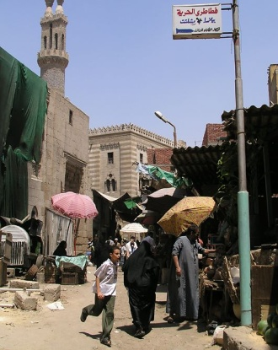
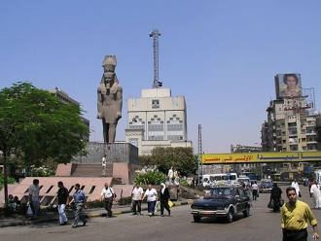
Chapter 1: The Challenge of the Emerging Labor Force
This chapter will review in detail Egypt’s population growth trends.
It will review in detail the expected growth rates in the labor force over the next two decades.
It will review:
Analysis of population growth rate trends
Growth prospects in the white collar labor force
Growth prospects in the blue collar labor force
Expected annual increases in number of jobs required by specialization
Expected job creation targets at current levels of GDP
A review of possible employment gaps; and
Recommendations for moving forward

Slide 4
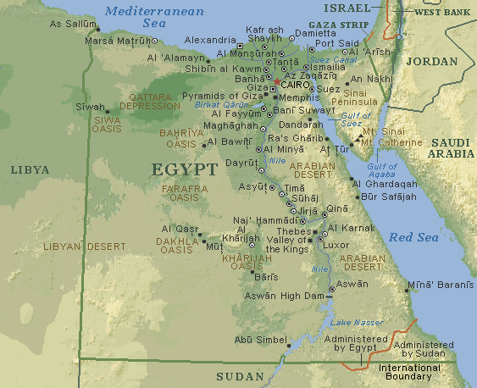
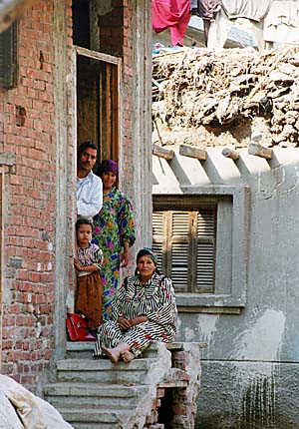
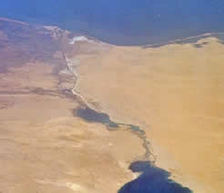
Chapter 2: The Challenges to Regional Development
This chapter will review in detail the geography of the population boom
Where the largest number of new jobs across the different governorates will be required, and the skills bases that will emerge
It will review what investments will be needed geographically to target the sources of rapid entry into the labor force.
This chapter will propose a regional development strategy based on an approach emphasizing areas of specialization.
For example, locating new educational facilities specifically in certain governorates or targeting investments in tourism or industry in specialist areas in particular locations close to large population centers.
This chapter will include:
A review of demographic trends in governorates
Investment in governorates across specific locations reflecting the last five years
An estimation of the required investment across various governorates to meet labor demand
A review of the size of investment that will be required on a geographic basis through the year 2025

Slide 5
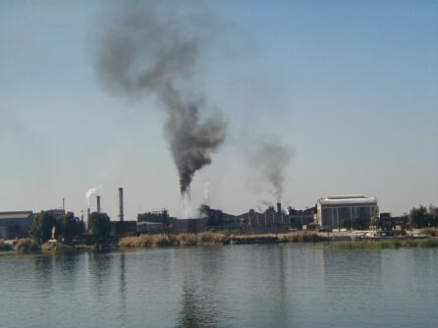
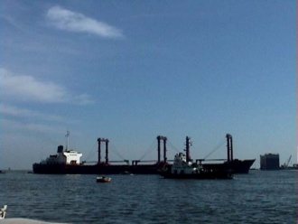
Chapter 3: Planning Industrial Development
This chapter will review in detail the industrial development challenges through the year 2025.
It will review in detail the investments that will be needed across the different governorates of Cairo to have industry fill part of the emerging labor force’s requirements
The chapter will look at specialized investments in specific areas that will give Egypt a comparative advantage vis-à-vis other countries in its industrial development.
It will take a traditional approach to identify what investments are best needed, where they are best placed, and how the private sector can become a full partner in developing Egypt’s industrial base
The objective is to achieve balanced regional industrial development and the chapter will review the following in detail:
Egypt’s industrial development challenges
Potential areas of specialization in select industrial areas
Promoting the role of the private sector
Identifying sources of financing
The road forward

Slide 6
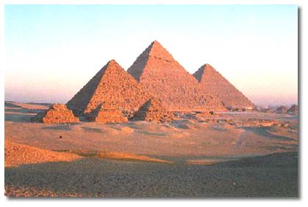
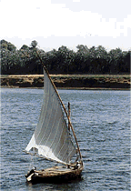
Chapter 4: Tourism
This chapter will review in detail the primary challenges to tourism development in Egypt, and what the key opportunities are for the development of the sector.
The chapter will analyze the tourism industry in terms of clusters; with a focus on different types of tourism (based on geography and type) and the synergies across different regions of the country.
Specifically, this will involve looking at:
How the overall trend of decline of Egypt’s tourism-along-the-Nile sector can be reversed
Key nodes of current growth: how can they be leveraged further (e.g. the Red Sea coast line)
Small specialist clusters development (e.g. Spas, etc.)
Trends in development of the industry for local citizens
Potential drivers for the industry’s growth through 2025

Slide 7
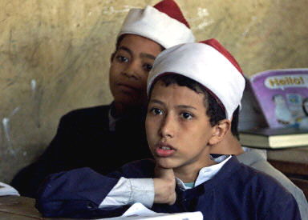
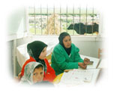
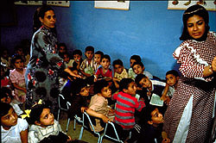
Chapter 5: Education
This chapter will analyze in detail Egypt’s current main challenges in specialist forms of education, and the likely course of development of the coming twenty years.
The focus of the chapter will be on higher education, digital literacy and lifelong learning. Specifically, this will include:
The evolution of higher education institutions over the past fifteen years and where they go from here
Training of trainers (and digital literacy) to improve the overall quality of education
The key impact of research and development and innovation and the development of a strategy to support the linkages between R&D and industry
Training needs of the private sector and specializations of the labor force, i.e. linking learning to professional development
Focusing on economic incentives, institutional regimes and innovation systems for knowledge-based economic development

Slide 8
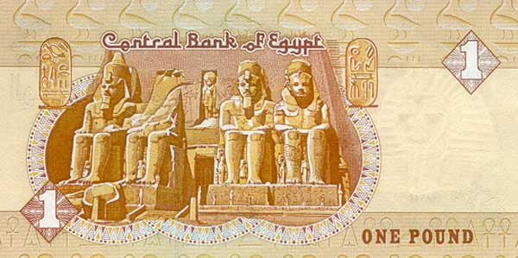
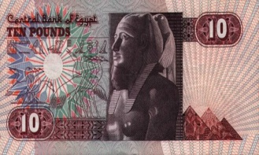
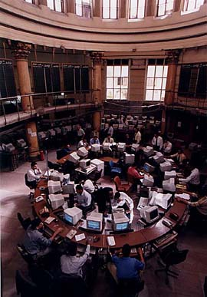
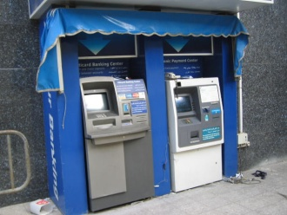
Chapter 6: Preparing Egypt for the Challenges of Becoming an Emerging Market
This chapter will focus on the key private and financial sector development issues which will be facing Egypt, and what the road map for moving forward should be to best-leverage Egypt’s rich opportunities for development.
The key issues to be tackled in this chapter will include:
Completing the unfinished privatization agenda for SOEs
Stimulating FDI
Developing export-driven growth strategies
Trade facilitation
Examining the role of the state in the provision of goods and services
Privatization of state banks
Supervision of the financial sector
Development of capital markets and non-bank financial institutions (e.g. leasing and factoring)

