Slide 1
VIRTUAL INVESTING

Slide 2
THE STOCK MARKET
An everyday term used to talk about a place where stocks and bonds are “traded”
Did you know?
The size of the world stock market is $36 trillion?
Companies use the stock market as a way to raise money

Slide 3
DIVERSIFICATION
Reducing risk by investing in different kinds of securities
Limit your risk exposure to a specific investment – choose stocks that are made up of different industries
A portfolio with all technology stocks is not diversified
Portfolio: a collection of investments

Slide 4
RISK TOLERANCE
The degree of uncertainty you can handle in regard to a negative change in the value of your investment
What would you do if you woke up one day and your stock lost half its value?
Don’t take unnecessary risk
Take the Risk Tolerance quiz

Slide 5
LEVERAGE
Using borrowed capital to increase the potential return of an investment
Example:
Margin: borrowing money from your brokerage firm to buy securities
Margin is EXTREMELY risky

Slide 6
DIVIDEND
A distribution of a portion of a company’s earnings
Quoted in terms of dollar amount each share receives
Dividends can be cash, stock or property

Slide 7
COMPOUND INTEREST
Interest that is paid on both the interest and the principal of an investment
Example
If you got 15% interest on your $1,000 investment the first year and end up with $150 interest
If I didn’t take the money out, the second year I would get 15% interest on both the $1,000 and the $150
This is why it’s so important to let your money grow in your account

Slide 8
EQUITY
A stock or any other security that represents an ownership interest
Example
Apple, Google, Facebook
There are almost 9,000 stocks in the U.S.

Slide 9
ASSET ALLOCATION
Balancing the risk vs. reward in your portfolio by adjusting percentages
Example
A third of your money in stocks, a third in bonds and a third in cash
Invest across different categories of investments

Slide 10
RATE OF RETURN
The amount of revenue an investment generates over a given period of time as a percentage of the original investment amount
Example
Earlier example, the $1,000 investment & $150 investment income
15% is the rate of return
Total return: actual rate of return of an investment. Includes interest, capital gains, dividends
Real return: return on an investment adjusted for inflation

Slide 11
HOW DO STOCKS TRADE?
On the Stock Exchange
Marketplace where brokers who represent investors meet to buy and sell securities
Two Primary Exchanges
New York Stock Exchange
NASDAQ
**We use indexes and averages to track overall direction of the market

Slide 12
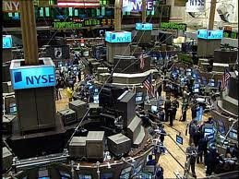
NEW YORK STOCK EXCHANGE
Founded in 1792
Face-to-face trading floor
Broker to specialist to broker
Stocks traded on NYSE: GE, McDonald’s, Coke, WM

Slide 13
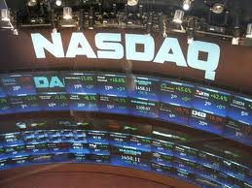
NASDAQ
“Virtual” over-the-counter
No central location
No floor brokers
Trading done through computers
Established in 1971
Tech-heavy listings – example: Facebook

Slide 14
DOW JONES AND S&P 500
Dow Jones Industrial Index
Oldest and best known index
Index of 30 widely held stocks
All companies are major factors in their industries
Standard & Poor’s 500 Index
Leading companies from all sectors of the economy
Benchmark for majority of growth mutual funds

Slide 15
WHERE DOES THE STOCK PRICE COME FROM?
Stock price is
Tied to how much investor’s perceive the entire company to be worth right now
AND
How much money the company is going to EARN in the future
Market Capitalization (market cap) = how much the total company is valued at
Stock price $≠$ Shares Outstanding
Pay attention to this and NOT just the stock price

Slide 16
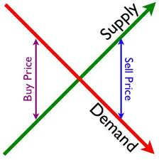
WHAT CAUSES STOCK PRICES TO CHANGE?
The easy answer…
Supply and Demand
More wanting to buy, less wanting to sell
Less wanting to buy, more wanting to sell

Slide 17
HOW DO YOU MAKE MONEY?
Investors make money in stocks in two ways
Dividends
Companies may make payment to shareholders as part of the profits
Capital Gains (CG)
Investors purchase shares in companies with the expectation that the price of the share will increase. This increase in share value is a capital gain.

Slide 18
SELECTING STOCKS
THINGS TO THINK ABOUT
No one way to pick stocks!
No fool proof formula
Come up with a strategy: A method for picking your stocks;
Are you interested in a specific industry? Sector?
Don’t put all your eggs in one basket
“Buy what you know. Stock tips are all around us. You can spot a good stock before Wall Street does.”
- Peter Lynch

Slide 19
SELECTING STOCKS
GIVE AN EXAMPLE OF A STOCK WITH A GROWING MARKET

Slide 20
STRATEGIES FOR STOCK SELECTION
1. Go with what you know: You see companies growing all around you
2. Markets: Current and future – a project must have customers today and ever more tomorrow or it isn’t growing
3. Economic Cycle: Is the economy expanding or slowing?
4. Avoid obvious risks
5. Selecting stocks for the stock market game:

Slide 21
STRATEGIES FOR STOCK SELECTION
1. GO WITH WHAT YOU KNOW
What products do you really like?
What is popular among your friends?
Who makes it?
Do you think it will continue to be popular?
Make sure to do your homework: know what the company does and how it’s doing financially – look at the news; their annual reports
If you can’t explain what the company does, then you shouldn’t buy it

Slide 22
STRATEGIES FOR STOCK SELECTION
2. MARKETS
A project must have customers today and even more tomorrow or it isn’t growing.
Does almost everyone own the product the company makes?
Stocks of a rapidly growing company are more likely to increase in price
What are the prospects for the company overseas? Think McDonald’s, Starbucks
Demographics also affect current and future markets: Will a large percentage of the population want this product? (ex. Facebook)

Slide 23
STRATEGIES FOR STOCK SELECTION
3. ECONOMIC CYCLE
Is the economy expanding or slowing?
How do you think the economy is doing? Is it growing or slowing?
GROWING ECONOMY: People who want jobs have them
SLOWING ECONOMY: High unemployment; companies cut back
EXPANSION: Cyclical stocks in industries such as cars, appliances, raw materials like aluminum, steels, cement, tools & equipment offer much higher returns and growth potential
RECESSION: stocks in defensive industries such as medicines, food, clothing, public utilities, etc. (generally decline less than stocks in other industries)

Slide 24
STRATEGIES FOR STOCK SELECTION
4. AVOID OBVIOUS RISKS
Beware of front page stories
When a stock or company gets a headline, it means everyone else knows about it too
You may want to stick with boring stocks
Evaluate current industry conditions: Industries include: transportation, automotive, food & beverage, retail/apparel, health care, entertainment, communication, utilities, financial and others
Do current events affect the businesses in the industry you’d like to invest in?
Will technology innovations affect your industry?

Slide 25
BUYING STOCKS
You buy stocks through a broker
Markets are open from 9:30am to 4:00pm
Full service or discount broker
Commission: the fee you pay the broker to buy and sell the stock

Slide 26
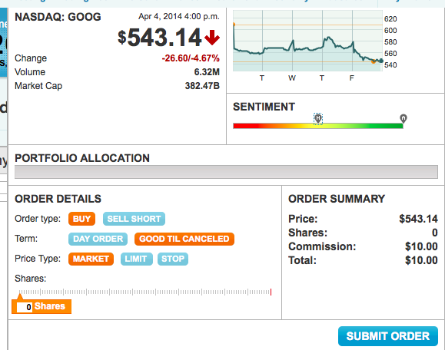
HOW TO PLACE AN ORDER
Market order: you buy or sell the stock at its current price
Limit order: you specify the price you will buy or sell the stock price at – when and if the market price reaches your limit-order price, the order is exhausted
Sell short: borrow from the brokerage house and sells to another;
Buy to cover: must buy those shares back at some point in time and return them to the lender

Slide 27
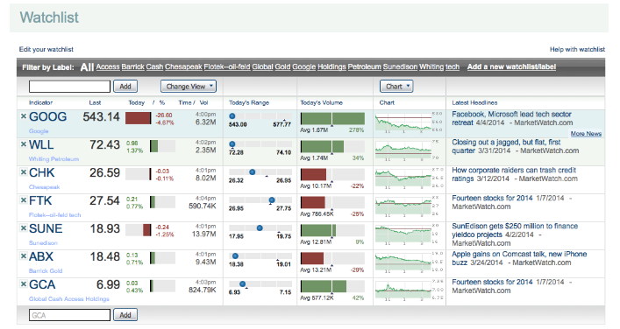
CREATE A WATCHLIST
A way to keep track of stocks/securities you’re interested in

Slide 28
EVALUATING PERFORMANCE
Real rate of return: subtract inflation from nominal rate of return
Total return: actual rate of return. Includes interest, capital gains, dividends and distributions

Slide 29
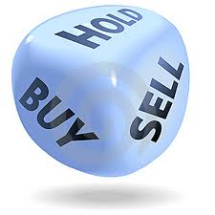
WHEN TO SELL
Must know when to get out
Fundamentals change:
Dividend is cut
You reach your target price
What Is Your Return?

