Slide 1
BUYING STOCK

Slide 2
PURCHASING OR SELLING STOCKS
Relying on brokerage or analyst recommendations
Evaluating analyst advice
Brokers and analysts tend to be overly optimistic
May encourage frequent trading to increase their commissions
Should remind you of tax effects of selling

Slide 3
PURCHASING OR SELLING STOCKS
Brokerage commissions
Discount brokerage firm: a brokerage firm that executes your desired transactions but does not offer investment advice
Full-service brokerage firm: a brokerage firm that offers investment advice and executes transactions

Slide 4
Financial Planning Online: Analyst Recommendations
Go to: http://finance.yahoo.com/?u
This Web site provides analyst recommendations about a stock that you specify. Type in the stock’s symbol, and then click on “Research.”

Slide 5
PURCHASING OR SELLING STOCKS
Buying or selling stock online
Low commissions
Convenient

Slide 6
Financial Planning Online: Trading Stocks Online
Go to: www.etrade.com
Click on: About E*Trade
This Web site provides information that you can use when making investment decisions. It also illustrates how you can trade stocks online, which typically reduces your transaction costs.

Slide 7
PURCHASING OR SELLING STOCKS
Placing an order
Name of the stock
Ticker symbol: the abbreviated term that is used to identify a stock for trading purposes
Buy or Sell — specify what you want to do

Slide 8
PURCHASING OR SELLING STOCKS
Number of shares
Round lot: shares bought or sold in multiples of 100
Odd lot: less than 100 shares of stock
Market order or limit order
Market order: an order to execute a transaction to buy or sell a stock at its prevailing market price
Limit order: an order to execute a transaction to buy or sell a stock only if the price is within the limits that you specify

Slide 9
PURCHASING OR SELLING STOCKS
Stop orders
Stop order: an order to execute a transaction when the stock price reaches a specified level; a special form of limit order
Buy stop order: an order for a brokerage firm to buy a stock when the price rises to a specified level
Sell stop order: an order for a brokerage firm to sell a stock when the price falls to a specified level

Slide 10
BUYING STOCK ON MARGIN
On margin: purchasing a stock with a portion of the funds borrowed from a brokerage firm
Federal Reserve limits margin to 50 percent
Margin call: a request from a brokerage firm for the investor to increase the cash in the account in order to bring the margin back up to the minimum level

Slide 11
BUYING STOCK ON MARGIN
Impact of margin on returns
Example
You want to buy 100 shares of Lynde stock, which would require $50 per share, or $5,000. You purchase the 100 shares on margin by paying $3,000 in cash and borrowing $2,000 from the brokerage firm at an annual interest rate of 12%. After one year, you sell the stock for $60 per share, or $6,000, and repay the brokerage firm the amount borrowed plus interest. Lynde stock paid dividends of $1 per share, or $100 over the year.

Slide 12
BUYING STOCK ON MARGIN
The return from buying a stock on margin is:
Return = $\frac{( S+D −I −LP)}{I}$
S = proceeds from selling
D = dividends received over investment period
I = initial cash investment
LP = amount paid to broker to repay loan
You borrowed $2,000, so your loan repayment is:
LP = $2,000 x (1 + .12) = $2,240

Slide 13
BUYING STOCK ON MARGIN
Your return on your investment is:
Return = $\frac{(S+D −I −LP)}{I}$
= $\frac{(\$6,000+\$100 −\$3,000 −\$2,240)}{\$3,000}$
= 0.2867 or 28.67%
Without the loan, your return would have been:
Return = $\frac{(S+D −I)}{I}$
= $\frac{(\$6,000+\$100 −\$5,000)}{\$5,000}$
= 0.22 or 22%

Slide 14
BUYING STOCK ON MARGIN
Impact of Margin on Risk
Example:
Suppose that Lynde stock declines to $40 per share (instead of increasing to $60 per share) by the end of the year, so you receive $4,000 when you sell the stock. Your return is: (cont’d next slide)

Slide 15
BUYING STOCK ON MARGIN
Your return on your investment is:
Return = $\frac{(S+D −I −LP)}{I}$
= $\frac{(\$4,000+\$100 −\$3,000 −\$2,240)}{\$3,000}$
= -0.38 or -38%
Using all cash your return would be:
Return = $\frac{(S+D −I)}{I}$
= $\frac{(\$4,000+\$100 −\$5,000)}{\$5,000}$
= -0.18 or -18%

Slide 16
ASSESSING PERFORMANCE OF STOCK INVESTMENTS
Comparing returns to an index
A convenient method of measuring performance
Price quotations for indexes used to measure stock performance are reported in financial newspapers

Slide 17
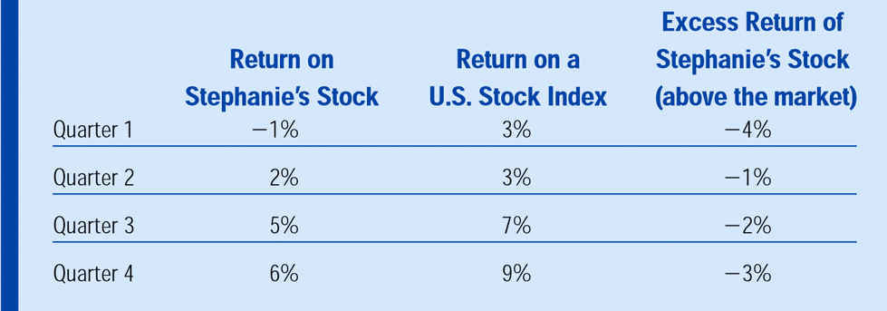
ASSESSING PERFORMANCE OF STOCK INVESTMENTS
Exhibit 15.1: Stock Performance Evaluation

Slide 18
FINANCIAL PLANNING ONLINE: STOCK MARKET SUMMARY
Go to: www.bloomberg.com
Click on: “Markets”
This Web site provides a summary of recent stock performance.

Slide 19
FINANCIAL PLANNING ONLINE: STOCK INDEX QUOTATIONS
Go to: http://finance.yahoo.com/m1?u
This Web site provides recent quotations of indexes that can be used as benchmarks when assessing your investment portfolio’s performance. Click on “Charts” to review historical movements in any specific index.

