Slide 1

Dealing with Difficult People: The Art of Conflict Management
Khaled F. Sherif
Chief Administrative Officer
The World Bank
A tailored seminar for Resource Management Professionals
Course Material available on:
http:\\www.ksherif.com

Slide 2
What is T.A.?
Transactional Analysis Is ...
Personality Theory Simplified
Motivation Theory Simplified
A Leadership Style
A Training Tool
An Easy Way of Understanding Who says What, and Why People Act and Interact the Way They Do
An Aid in Dealing with Conflict Problems

Slide 3
Reasons for Popularity of T.A. In Management
Simple
Language
Built-in Humor
Non-Threatening
Self-analysis
Appropriate
For “Normal
People”
Demonstrated
Success in Bus.
Organizations
Useful at Work &
At Home

Slide 4
Basic Human Ego States
(Personality States)
THREE BASIC
EGO STATES
FURTHER BREAKDOWN OF EGO STATES
LECTURING, CRITICIZING, MANY “OUGHTS”, “SHOULD” &”DON’TS”
P
(PARENT)
CRITICAL PARENT
NURTURING PARENT
CONSOLING, “TAKING CARE” OF OTHERS, SYMPATHY
A
(ADULT)
ADULT
OBJECTIVE, RATIONAL, ORIENTED TOWARD PROBLEM SOLVING, DE-EMPHASIZE EMOTION
MODIFIED BEHAVIOUR TO CONFORM TO ADULT EXPECTATIONS, MANUPULATIVE, SUMBISSIVE
C
(CHILD)
ADAPTED CHILD
NATURAL CHILD
PLAYFUL, IMPULSIVE, NATULRALLY CURIOUS &CREATIVE, FUN LOVING, REBELLIOUS

Slide 5
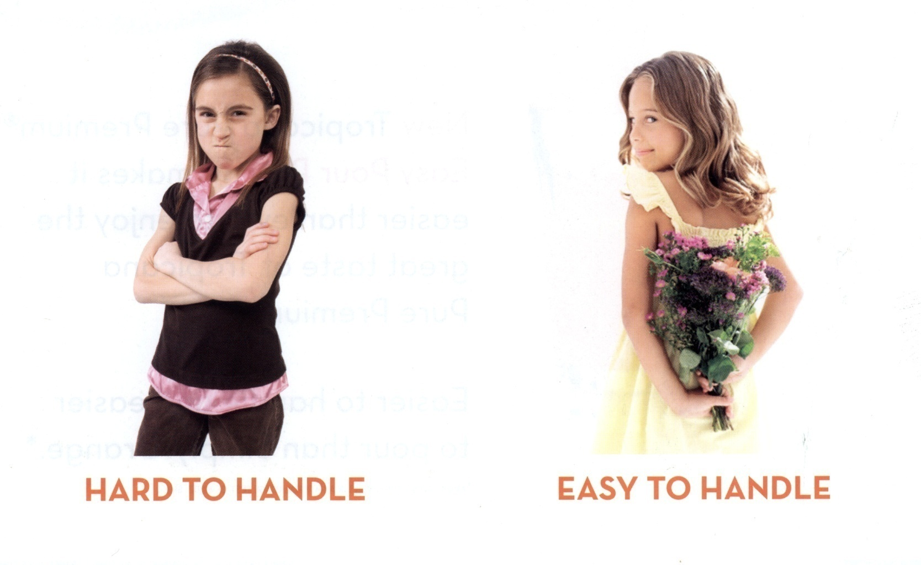
Critical vs. Nurturing Parent

Slide 6


Natural Child vs. Adult

Slide 7
Typical Ways of Expressing Ego States on the Job
CRITICAL
PARENT
“CAN’T YOU EVER COMPLETE YOUR DASHBOARD ON TIME?”
“WHAT, IT TAKES TWO WEEKS TO PREPARE A BUDGET PROJECTION?
“I’M SURPRISED AT YOU, YOUR PROJECTIONS WERE RIGHT FOR ONCE”
NURTURING
PARENT
“TAKE A REST STOP ON YOUR WAY BACK, THE MISSION WAS TOO LONG”
“CAN I HELP YOU EDIT THE PCD, HE’S ASKING TOO MUCH OF YOU
“YOU’VE DONE A SWELL JOB ON THAT MID-YEAR SUBMISSION, BUT YOU MUST HAVE BEEN UP ALL NIGHT”
ADULT
“WHAT ARE THE ALTERNATIVES IF TO PREVENT AN OVERRUN?”
“CAN’T WE REACH SOME SORT OF COMPROMISE ON CROSS SUPPORT?”
“WHAT CONSEQUENCES WILL THIS SAP DELEGATION HAVE?”
ADAPTED
CHILD
“ANYTHING YOU SAY, YOU’RE THE CAO”
“SORRY,THE ANALYSIS IS LOUSY I’LL TRY TO IMPROVE IT.”
“WHAT WOULD AFR DO WITHOUT YOU”
NATURAL
CHILD
“NOBODY FOLLOWS THAT PROCUREMENT RULE ANYWAY.”
“FORGET ABOUT IT, HE’S JUST A SECTOR MANAGER”
“IT’S MY AWS DAY, OF COURSE I’M NOT COMING TO HELP WITH THE END YEAR PROJECTIONS”

Slide 8
Types of Interpersonal Transactions
P
P
P
P
P
P
A
A
A
A
A
A
C
C
C
C
C
C
COMPLEMENTARY
CROSSED
ULTERIOR
P
P
P
P
P
P
A
A
A
A
A
A
C
C
C
C
C
C
EXPECTED RESPONSE, NO CONFLICT
PRODUCE CONFLICT, STOP COMMUNICATION, HURT FEELINGS
VERBAL COMMUNICATION (A CRITICAL PARENT CAN BE SILENT !!!)
NON-VERBAL HIDDEN MEANING

Slide 9
Examples of Complementary Transactions on the Job
RMO: “THE PROJECTIONS WERE DUE NEXT WEEK BUT I FINISHED THEM EARLY”
TTL: “YOU SURE KNOW HOW TO TAKE CARE OF ME, ”
SECTOR MANAGER: “WHAT CAN WE DO TO BALANCE THE BUDGET?”
RMO: ONE OF MY COLLEAGUS HAS AN UNDERRUN , MAYBE HE CAN HELP US OUT IN Q4.”
RMO: “DON’T FORGET TO BRING YOUR TENNIS RACQUET TO THE RM FORUM ”
RMA: “I’M GLAD YOU HAVE YOUR PRIORITIES RIGHT”
P
P
P
P
P
P
(1)
A
A
A
(1)
A
A
A
C
(2)
C
C
(2)
C
C
(1)
C
(2)
NURTURING PARENT TO ADAPTED CHILD
ADULT TO ADULT TRANSACTION
NATURAL CHILD TO NATURAL CHILD

Slide 10
Examples of Crossed Transactions on the Job
SECTOR MANAGER: “ DID YOU FINISH THE BUDGET ESTIMATES?”
RMA: “HOW CAN I IF THE WHOLE PROCESS DOESN’T MAKE SENSE.”
TTL ON THE PHONE: COME SEE ME IN MY OFFICE NOW!” (DEMANDING TONE OF VOICE)
RMA: “WHY DON’T YOU COME OVER HERE? IT’S JUST AS CLOSE!”
TTL: “WHAT’S THE RULE ON GETTING MORE CAPITAL BUDGET?”
RMO: “WHY DON’T YOU LOOK UP THE RULE FOR YOURSELF”
P
P
P
P
P
P
P
P
(1)
(1)
(1)
A
A
A
A
A
A
A
(1)
A
(2)
C
(2)
C
C
(2)
C
C
C
C
(2)
C
ADULT-TO-ADULT CROSSED BY CRITICAL PARENT-TO-CHILD RESPONSE
PARENT-TO-CHILD CROSSED BY CRITICAL PARENT OR REBELLIOUS CHILD RESPONSE
ADULT-TO-ADULT CROSSES UP BY DISCOUNTED CHILD TO PARENT RESPONSE

Slide 11
Examples of Ulterior Transactions
RMA: “SORRY, THE PROJECTIONS WON’T BE READY FOR TOMORROW’S DEADLINE.”
SECTOR MANAGER: “IT’S O.K. I’LL CALL THE CAO AND EXPLAIN WHY”
RMA: “WHY CAN’T I HAVE A LAPTOP SO I CAN WORK FROM HOME?”
IT SPECIALIST: “I DON’T SEE THAT AS A PROBLEM, LET ME CALL MY MANAGER AND SEE WHAT I CAN DO”
P
P
P
P
(1)
A
(1)
A
A
(1)
A
(2)
(2)
(1)
C
(2)
C
C
C
(2)

Slide 12
Stroking
The Types of Strokes You Seek Depend on Your Okayness
POSITIVE
STROKES
NEGATIVE
STROKES
CONDITIONAL
STROKES
PRAISE
COMPLEMENTS
RECOGNITION
AFFECTION
REWARDS
SYMPATHY
CONSOLATION
SELF-SATISFACTION FROM JOB WELL DONE
ALWAYS STRINGS ATTACHED & THE STRINGS MODERATE
PUT-DOWNS
CRITICISM
DEGRADING
RIDICULE
SCOLDING
PUNISHMENT
DISCOUNTING
ALWAYS STRINGS ATTACHED & THE STRINGS HAVE SERIOUS CONSEQUENCES
STROKES WITH ULTERIOR MOTIVES (ADAPTED CHILD)
STROKES GIVEN FOR WHAT YOU DO, RATHER THAN FOR WHO YOU ARE (CRITICAL PARENT)
PERFORMANCE ORIENTED
STROKE (STRINGS USUALLY
LINKING A DELIVERABLE TO
A PROMOTION
(ADULT)
ACCOMODATION &
CONFORMITY ORIENTED
STROKES (CRITICAL PARENT
ATTEMPTING TO SHAPE
BEHAVIOR AND CREATE
ADAPTED CHILDREN
TYPOLOGY)

Slide 13
Critical Parent - Damaged
Do critical parents show patterns of abnormal behavior?
To some degree they are in fact “damaged”.
Some are exhibiting behaviors that are very black and white
He’s great – he’s useless, there is no in between
You are either a God, or a waste of space
The reason critical parents are damaged is that they in some instances hurt others to feel better about themselves
He’s a fool, because he’s not as experienced as I am
He’s an idiot, because he didn’t go to the same school that I went to
He’s useless because he doesn’t write well, or present well, and is comparing a poorer skill set with his own
Every time he finds someone who doesn’t measure up, he/she feels better about who they are

Slide 14
Basic Psychological (Life) Positions: Your Self Image
1. I’M OK; YOU’RE OK
“WIN- WIN”, HEALTHY, OPTIMISTIC, ADULT-TO-ADULT INTERACTION. IDEAL LIFE POSITION ON & OFF THE JOB. NUMEROUS GOLD STAMPS
3. I’M NOT OK; YOU’RE OK
CHILD-TO-ADULT EGO STATE ACTIVATED. FEELINGS OF INFERIORITY, GUILT, DISAPPOINTMENT IN SELF PREDOMINANT. USUALLY TRIGGERED OUT OF FEAR
2. I’M OK; YOU’RE NOT OK
CRITICAL PARENT EGO STATE ACTIVATED. MAY EVOLVE FROM BEING HURT OR DISCOUNTED. FEELS DISTRUST, ANGER, SUPERIORITY. GRAY STAMPS IN PLAY
4. I’M NOT OK; YOU’RE NOT OK
LACKS TRUST IN OTHERS. FEELINGS OF HOPELESSNESS, DESIRE FOR REVENGE, OFTEN EXTREME DEPRESSION. SERIOUS BLACK STAMPS IN PLAY
5. I’M OK, I’M NOT SURE ABOUT YOU
(KEEP IN MIND GRAY, BLACK & GOLD STAMPS)

Slide 15
I’m OK, I’m Not Sure About You
Typically, this is the state that your in when you meet someone for the first time
However, this not necessarily always the case
You can meet someone that is so much like you, that it triggers an “I’m OK, Your OK” initial response, until proven otherwise
You can also meet someone so much not like you, that it triggers an “I’m OK, Your Not OK” initial response, until proven otherwise
In most instances, relationships are formed by transactions that either tend to be positive, or tend to be negative
If the transactions remain positive, over time gold stamps accrue and you start building an “I’m OK, Your OK” relationship
If the transactions are pre-dominantly negative, over time gray stamps accrue and you start building an “I’m OK, Your Not OK” relationship
If the negative gets nasty, really nasty, then an “I’m Not OK, Your Not OK relationship develops

Slide 16
I’m OK, Your OK – One of It’s Most Common Forms
When you have a relationship with someone in this mode gold stamps, possibly several of them, have accrued
There is mutual respect between you and most importantly there is trust
You can rely on that person, and they can rely on you
You know more about them than what is just at work. You might know there kids, and they might know yours. You share things that are not just professional, but are private as well
You see this in the Bank consistently among people that travel together often and in very difficult environments
Many of my “I’m OK, Your OK” relationships accrued from going to countries like Bosnia immediately after the war. With gun shot fire almost every night, we all started checking in on each other, and were concerned when someone was late for breakfast, or late from a meeting
That concern, created a pattern of caring, that interface led to the development of gold stamps
You tend to have lunch more often with people in this category, or you invite them to your home. This is your tennis partner, but more importantly, this is your “friend”

Slide 17
I’m OK, Your Not OK – One of It’s Most Common Forms
Unfortunately, most of our relationships are in this mode
This appears when we think we’re smarter, better, or more committed than someone else
It also comes from repetitive disagreements, or when you consistently are overruled
For example, if you are a lead TTL and in the middle of an important meeting when the boss is asking everyone for their opinion, he turns to you and says: “Can you photo copy this for the rest of the group?”
You might do it, but it triggers a gray stamp
In turn this gray stamp, combined with others, defines your relationship with this person squarely in the “I’m OK, Your Not OK” category
On average, about 8 of every 10 people we work with are labeled by us in this category
When this happens work does not tend to be fun
This is what gives you the feeling of not wanting to get out of bed Monday morning and you start thinking “Oh my God, not again”

Slide 18
I’m Not OK, Your OK – One of It’s Most Common Forms
This can stem from a third party reaction to a I’m Not OK – Your Not OK set of transactions
A colleague has taken your supervisor to an administrative tribunal
You are asked to testify
You have such fear of that supervisor that when asked questions about your boss, you answer them in a way that doesn’t get you into trouble;
Problem is, now you have let your colleague down who you knew was in the right
Behavior like this is normal, but is usually generated our of fear
If the boss explains an action related to a staffer implying the person is incompetent, you many know this not to be true, but you want to avoid conflict with your boss, so you say nothing, or in its worst form, you implicitly or explicitly support this judgment
When faced statements like “What an idiot”, you say nothing even when you disagree
When you interact with the person thereafter, the I’m Not OK, Your OK mode kicks in
Yup – you’ll pick up the lunch tab too.

Slide 19
I’M Not OK, Your Not OK – One of It’s Worst Forms
Why do some really nasty things get said about people in the work place, a lot of the time so absurd that they poison the work environment?
This consistently occurs when a relationship between two people deteriorates to the "I'm Not OK, Your Not OK" category. At this stage, one person, usually the subordinate, feels so wronged by their supervisor that they feel justified in saying, or putting in writing (usually in anonymity), allegations that are extremely personal and accusatory.
If you have ever come across this, it is easy to spot.
The accuser is usually very emotional and deeply troubled by his or her interaction with their supervisor. The person may feel threatened, was threatened, or generally feels humiliated and discounted.
The response to this is often self defense and this can take on various forms. When the worst forms of "I'm Not OK, Your Not OK" kick in, it is like a bad divorce between two people that is getting really nasty.
In its worst form, people then start taking sides, and transference sinks in. The office atmosphere becomes divisive and a pattern sets in that usually leads to new and more troubling accusations or events occurring weekly, or even daily.

Slide 20


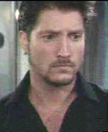
Conflict at Work: I
Did You Hear the Latest (Reuters in the work place)?
RMO/RMA PLAYING THE ROLE OF “REUTERS” SHARING OFFICE RUMORS AND GOSSIP. THE RUMORS KEEP YOU ON EDGE, BUT CONSISTENTLY PROVE TO BE WRONG AND TEND TO CREATE AN I’M OK YOUR NOT OK ENVIRONMENT
KICK ME
“SORRY, I COULDN’T FINISH THE MID-YEAR TOO MANY TASKS AT THE SAME TIME”
“OH MY GOD THIS PLACE IS GOING TO PIECES”
“THAT’S OK, I UNDERSTAND…”
(ULTERIOR MESSAGE: “THAT’S NOT OK AND MAN ARE YOU GOING TO GET IT”)
PARTNER’S SCRIPT: I’M OK; YOU’RE NOT OK.

Slide 21
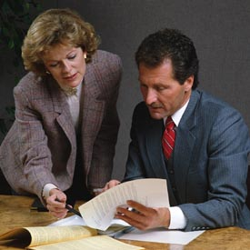

Conflict at Work: II
WOODEN LEG
YES, BUT…
IF IT WEREN’T FOR MY BACK TROUBLE, I COULD HAVE FINISHED THE WPA SUBMISSIONS YOU NEEDED FOR TODAY’S MEETING.
“WHY DIDN’T YOU SEND ME THE QBR FOR CLEARANCE?”
“WELL, THE SUBMISSION ISN’T FULLY FINISHED YET IS IT?”
USES REAL OR IMAGINED HANDICAP AS CONSTANT EXCUSE. NEGATIVE SELF-IMAGE: I’M NOT OK; SELF-PITY. CONTINUALLY LOOKING FOR CONSOLATION OR PITY FROM NURTURING PARENT.
A FREQUENT GAME BETWEEN STAFF AND LINE PERSONNEL. THE “HOOKER” MAY ACTUALLY ASK THE OTHER PERSON FOR HELP WITH SOMETHING, THEN THE OTHER PERSON SYSTEMATICALLY FINDS FAULT WITH ONE SUGGESTION AFTER ANOTHER.

Slide 22
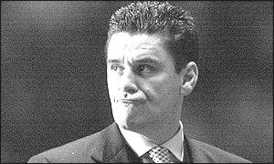
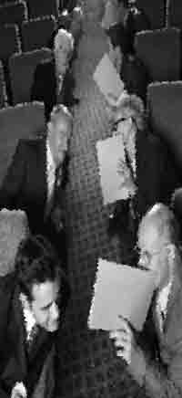
Conflict at Work: III
AIN’T IT AWFUL
HURRIED CAO
“THESE MBAs STRAIGHT OUT OF THE PROGRAM, & THEY THINK THEY KNOW EVERYTHING….”
“…I’VE GOT TO DO EVERYTHING MYSELF AROUND HERE!”
“YEAH, WHAT DO THEY KNOW”
COMPULSIVE MANAGER WHO TAKES ON MORE AND MORE RESPONSIBILITY, OFTEN MORE THAN HE/SHE CAN HANDLE, THEN COMPLAINS ABOUT HOW BUSY HE/SHE IS. MAY STILL BE PLAYING OUT THE ADAPTED CHILD EGO STATE IN RESPONSE TO CRITICAL PARENT WITH HIGH EXPECTATIONS. SEEKS NURTURING PARENT STROKES.
GOSSIP TYPE COMPLEMENTARY TRANSACTIONS BETWEEN TWO CRITICAL PARENT EGO STATES. MAY FOSTER TEAM SPIRIT, BUT IN A NONPRODUCTIVE, NON-OBJECTIVE DIRECTION. POPULAR WITH COMMITTEES.

Slide 23
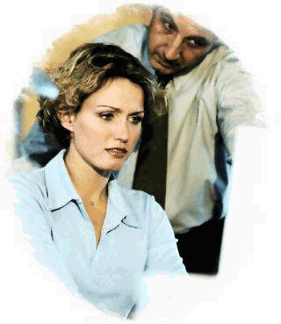

Conflict at Work: IV
STUPID
NIGYSOB
“HOW COULD I HAVE BEEN SO STUPID, I DELETED THE SPREADSHEET BY ACCIDENT AND I DON’T HAVE A BACK-UP”
“NOW, I’VE GOT YOU, YOU S.O.B”
CLASSIC EXAMPLE OF PERSECUTOR SETTING UP HIS VICTIM. LOVES TO ACTIVATE HIS CRITICAL PARENT EGO STATE. OFTEN SETS IMPOSSIBLE TASKS FOR SUBORDINATES, GIVES INCOMPLETE INSTRUCTIONS, THEN GETS READY TO GIVE A KICK.
EXAMPLE:
CAO: “I HEAR THEY ARE LOOKING
FOR AN RMO IN CFR”.
RMA: “HOW ABOUT YOUR RECOMMENDING ME FOR THAT POSITION?”
CAO: “YOU CONSIDER YOURSELF TO BE AN RMO, REALLY?”
MAKES DUMB MISTAKE, GETS NEGATIVE STROKES FROM CRITICAL PARENT AND THEN BECOMES CRITICAL PARENT ALSO. A PATTERN OF TRANSFERANCE BUILDS

Slide 24

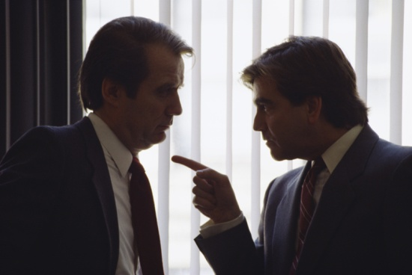
Conflict at Work: V
NOW I/WE’VE GOT YOU YOU SOBs
REGIONAL DASHBOARD
IN AN RM UNIT DOMINATED BY
‘CLIQUES’ THE SECOND IN COMMAND TAKES CHARGE
A DASHBOARD IS CRITICIZED HEAVILY AND DESCRIBED AS A TERRIBLE PRODUCT
A NEW RMO IS ASSIGNED
HE REVERSES THE SECTIONS BUT DOESN’T ALTER THE CONTENT
THE DASHBOARD NOW RECEIVES A GLOWING REVIEW
…BUT ALL THAT’S REALLY CHANGED IS THE RMO WORKING ON THE DASHBOARD!!
NOW IT’S TIME FOR HIM AND HIS TEAM TO GET EVEN WITH THOSE THAT ARE NOT MEMBERS OF THE ‘OK’ CROWD

Slide 25


Conflict at Work: VI
UPROAR
IF IT WEREN’T FOR YOU
“WELL,IF YOU SHOWED ME HOW TO DO IT FROM THE BEGINNING THIS WOULDN’T BE HAPPENING”
“IF IT WEREN’T FOR THAT CAO, I COULD HAVE BEEN AN RMO BY NOW.”
“CAN’T YOU INPUT AN I/O RIGHT JUST ONCE?”
BOTH PLAYERS TRADE INSULTS OR ABUSES, ENGAGE IN ATTACK AND COUNTER-ATTACK. OFTEN DETERIORATES INTO SHOUTING MATCH. TWO I’M OK; YOU ARE NOT OK POSITIONS CLASHING. WORSE A MANAGER CAN THEN TAKE SIDES CAUSING MORE DAMAGE
“IF IT WEREN’T FOR SOMEONE OR SOMETHING” IS A FAVORITE COP-OUT, BLAME OTHERS FOR SUPPOSEDLY UNAVOIDABLE CIRCUMSTANCES FOR LACK OF ACHIEVEMENTS, CHILD EGO STATE ACTIVATED.

Slide 26
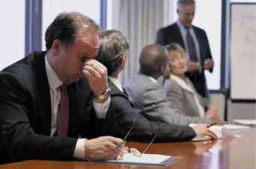

Conflict at Work: VII
LET’S YOU AND
HIM FIGHT
RAPO
“THAT NO-GOOD
SO-&-SO!”
“SECTOR MANAGER: “HAVE YOU SEEN ALEX THIS MORNING?”
SUBORDINATE “NO, ALEX NEVER GETS IN THIS EARLY!”
USED TO DEVELOP TRANSFORM THE “I”M OK, I’M NOT SURE ABOUT YOU” MODE INTO “I’M OK, HE/SHE IS NOT OK”
“I WOULD’T WANT YOU TO TELL ANYBODY WHO CLUED YOU IN, BUT DID YOU KNOW THAT YOUR CAO DIDN’T SUPPORT YOUR PROMOTION AT THE SECTOR BOARD?”
SAYING THINGS “IN CONFIDENCE” IS OFTEN AN ULTERIOR TRANSACTION. PLAYER HAS A HIDDEN AGENDA, ACTIVATES HIS MANIPULATIVE CHILD EGO STATE.

Slide 27
Conflict at Work: IX
MY SRI WAS AWFUL
I’M NOT SAYING HELLO
“I GOT A 5 THIS YEAR, WHAT DID YOU GET?.”
“…HERE’S A GOOD SNUB FOR YOU FELLA!”
“I’M NOT SURE, BUT I CONSIDER THINGS LIKE THIS PERSONAL….”
PLAYING OUT THE CRITICAL PARENT EGO STATE IN RESPONSE TO WHAT WAS PERCEIVED TO BE A CRITICAL PARENT TRANSACTION. THE MESSAGE IS I’M OK YOUR NOT OK. BUT, WHAT HAPPENS IF THIS PERESON LATER BECOMES YOUR BOSS?
THIS CAN EASILY BECOME A TRANSACTION BETWEEN TWO CRITICAL PARENT EGO STATES. USUALLY SPREADS AND CREATES MORE CRITICAL PARENTS BY TRANSFERENCE

Slide 28
Conflict at Work: XI
TRAIN YOUR OWN REPLACEMENT?
RMA BEING ASKED TO EFFECTIVELY TRAIN THEIR OWN REPLACEMENT EITHER BY BEING DUPED, OR BEING TOLD YOU ARE PART OF THE MANDATORY ROTATION EXERCISE, BUT THIS IS WHAT YOU NEED TO DO BEFORE YOU GO
DON’T BEG
“I CAME TO SEE YOU TO CHECK IF THERE IS ANYTHING WE CAN DO TO IMPROVE MY PERFORMANCE REVIEW AND SALARY ADJUSTMENT”
“OH MY GOD I CAN’T BELIEVE THIS”
“I JUST HATE PEOPLE WHO BEG…”
SCRIPT: I’M OK; YOU’RE NOT OK.

Slide 29
Transference
What is Transference?
Transference occurs when two people have a “I am OK, Your OK” relationship, and a third-party is introduced who has a “I am Not OK, Your Not OK” relationship with one of these two people
Very often, the relationship state that exists between the third-party and the principal is ‘transferred’ to the other person. This often creates a “I am OK, Your Not OK” relationship with that person as well

Slide 30
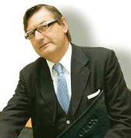

First Party Transference
What is First Party Transference?
First party transference occurs when a person, usually a supervisor, has had a bad experience with a subordinate
The subordinate has failed to meet the expectations of the boss, by giving him/her a sub-standard product, by not being timely, or possibly by consistently getting complaints that the person mishandled relationships with peer or clients on that job
From this outcome, the supervisor starts forming an “I’m OK, He’s Not OK” lens towards the subordinate.
This thinking starts getting the supervisor to avoid giving this person the next high profile project, or to begin to discount this person more generally
?

Slide 31

An Example of Second Party Transference
  Second party transference starts occurring when someone is passing on a judgment about a person to someone else
  For example, when Wei and Thomas have an “I’m OK, Your OK” relationship
  And, Thomas has an “I’m OK, Your Not OK” relationship with Lars, what do you think can happen?
  What happens when Lars is only partly aware of this tension?
+
̶̶
Lars
Thomas
Wei

Slide 32


Third-Party Team Transference
  An example of team transference can involve a new Director who comes in and has an “I’m OK, Your OK” relationship with a particular group. The new Director tends to work with a defined team (click) and to rely on old relationships heavily
  Two or more team member in the new manager’s click have an “I’m OK, Your Not OK” relationship with Lars and Alex and they bad mouth them to the Director
  The Director, through transference, forms a negative opinion of Lars and Alex, and therefore, they are selected for only the worst assignments in the department (reassigned from Turkey to Tajikistan)
+
+
+
+
+
+
̶̶

Slide 33
Image Transference
What is Image Transference?
When people start developing a perception of who you are, an image is formed from one person, and is transferred from one person to another person and/or to a group of people
There are different types of image transference that involve groups including:
  Emissary
  Clicks vs. Teams
  New Manager
  Old Manager

Slide 34
Emissary Transference
Characteristics
A senior manager appoints/inherits a surrogate who tends to be very a critical parent
The surrogate has terrible communication skills
The image of the senior manager is hurt by transference as this is the person staff see and work with the most
“We just can’t work with Jim, what were they thinking when they hired him”? (Remember PW, RC and KK)

Slide 35
New Manager Transference
Characteristics
A new manager is appointed and his predecessor is beloved by several members of the existing team
They are unhappy with the selection and cannot understand why management made a change
Staff are happy to hear negative views of the new manager from others to transfer to the rest of the team
“Why couldn’t they see that everything was fine as it was, how can management be so stupid”

Slide 36
Old Manager Transference
Characteristics
A new manager is appointed to a new position, but has various strong I’m OK, Your OK, relationships with people in his old work group
The new manager starts intimidating staff in his new work group to nudge them out.
“If I just had Susan and Marie here, we could be so much more efficient, and who are these bums anyway”

Slide 37

Clicks vs. Team Transference
Characteristics
Manager trusts select people in the work group more than others
Over time the manager tends to discount the opinions of those he doesn’t trust and puts them at arms length and doesn’t give them important assignments
“It so good to see how well we work together as a team isn’t it?”
“Can you believe those guys and their click – this is awful”

Slide 38
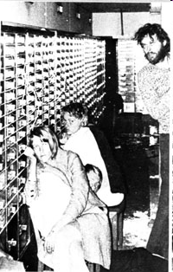
How Bad Managers Survive:
Understanding Stockholm Syndrome
Psychology and human behavior manifest themselves most prominently in the most extreme of circumstances
  That is why we can learn a great deal from these instances and apply them to the workplace
In 1973, a group of robbers held employees of a bank hostage for a short period of time in a farm house Stockholm, Sweden
After being surrounded by police and barricading themselves with the hostages and making repeated threats to kill them, the criminals eventually found that they had no option other than to surrender
  What is remarkable about this case is that in this short period, the hostages began to sympathize strongly with their captors—eventually refusing to testify against them and even coming together to raise money for their criminal defense

Slide 39
Transactional Analysis
The 80/20 rule: 80 percent of your success is in managing people and 20 percent relates to doing your job well
If this is true, what is the level of “okayness” with your subordinates, peers, supervisors and most important clients?
It is important to determine where you stand with the people working closest to you. With whom do you have gold stamps and with whom do you have gray stamps

Slide 40
Transactional Analysis
Back to the 80/20 rule: This rule also says that your job environment is functional when 80 percent of your relationships at work are based on the I am OK your OK principle
If the opposite is the case than your job is dysfunctional
Most of us are somewhere in between.
You can still have a lot of “not OK” situations at work and still be effective – it just won’t be fun.

Slide 41
Transactional Analysis
Keep in mind that the 80/20 rule can still be in your favor but you could still have major problems.
Why? Because having an I am not OK your not OK relationship with your driver in Bosnia is less relevant – having this relationship with your boss is relevant
Keep this in mind for your home situation as well

Slide 42
Transactional Analysis
To understand why some of your relationships work and others don’t you need to assess your own behavior and that of others.
Which mode are you in the most, parent, adult, child?
Which mode are your subordinates and peers in?
Which mode is your boss in?

Slide 43
Transactional Analysis
Understanding your relationships with others relates to gold stamps and gray stamps
Whether we like it or not we accrue gold stamps for situations we handle well and gray stamps for situations we handle badly
This is what defines our “okayness” with other people
For some one gray stamp is enough to put you in the category of “I am OK your not OK”
For others a ton of gold stamps may not do much at all

Slide 44
How to Minimize Conflict
Realize that it takes two to generate conflict
Conflict is indeed a choice
Always avoid being a third party in any conflict
Turn on your adult ego state in critical situations
It’s always ok to play “nurturing parent” until other person is ready to stand on his own feet
Separate the person from the act; Do not criticize personality
If you find yourself in front of a critical parent, realize that there is no need to defend yourself if you are not the cause of his/her problem but merely an opportunity to find relief from pressure
Always try and move the person out of an ego state that is damaging

Slide 45
How to Manage Conflict
Refuse to participate
Keep changing your ego states until you find what works
Manage your own critical parent reactions
Manage transference by reaching out to others
Never present yourself as a victim
Manage your relationships more broadly
Avoid linking yourself to a camp, never be in us against them mode
Survive, change is always around the corner
45
Notes:
45

Slide 46
Basic Guides Which Can Help You in Working With People
Cooperation cannot be forced
You communicate more through action than words
Sentiment and emotion count
Everyone likes to feel important and avoid ignoring someone whenever possible
Everyone wants to know that they matter
Don’t forget to show appreciation consistently

Slide 47
A Few Final Words of Wisdom
The definition of being wise is when you have something stupid to say don’t say it
One nice thing about people with big egos is they don’t talk about other people
The person with the least expertise has the most opinions
If you tell the truth, you don’t have to remember anything
Just because everything is different doesn’t mean anything has changed
Good judgment comes from bad experience, experience comes from bad judgment
Anyone can admit that they were wrong – the true test is admitting it to someone else
When things go wrong, don’t go with them

Slide 48
Closing Thoughts
Finally, remember there are situations that can’t be fixed, just too many black stamps
Fighting is just some one screaming out “I’M OK, YOUR NOT OK”, but to what effect?
Sometimes no matter how much it hurts, how much you care for a job, it’s just over and you need to walk away
Always try and move forward, and try and make the best from a bad situation and learn from it
There is a time to thrive, survive and to simply move on

Slide 49
Closing Thoughts
Always create alliances as a fallback situation, otherwise you will be out there on your own. You need to reinvent yourself from time to time, and always think forward not backward
Inherently, there will always be some sort of conflict stemming from jealousies, ambitions of others, your own desire to succeed, and various forms of office politics which you may not be able to avoid
But, as the Dali Lama said “we are put on this earth to help others, and if you can’t help them don’t hurt them”. This is important to remember because sometimes it is easy to hurt someone because this benefits you in some way
None of us want to be that person, and if we all resist hurting someone because we have something to gain, we all win. And, remember great minds discuss ideas, average minds discuss events, and small minds discuss people

Slide 50
Review of Buzz Words
(But They Can Also Be Tools for Better Understanding)
GAMES:
NIGYSOB
AIN’T IT AWFUL
KICK ME
RAPO
UPROAR
STUPID
(WHAT OTHERS:
CAN YOU NAME?)
COLLECTING STAMPS:
GOLD STAMPS
GRAY STAMPS
PARENT
ADULT EGO STATES
CHILD
PAYOFF:
CONSCIOUS
UNCONSCIOUS
CRITICAL PARENT
NURTURING PARENT
NATURAL CHILD
ADAPTED CHILD
ROLES:
VICTIM
RESCUER
PERSECUTOR
STROKES:
POSITIVE
NEGATIVE
CONDITIONAL
TRANSACTIONS:
COMPLEMENTARY
CROSSED
ULTERIOR
PARENT TAPE
CHILD TAPE
BASIC LIFE POSITION

